Slide 1
Case
A 55-year-old woman is admitted with severe
headache and decreased consciousness, and found to have
a subarachnoid hemorrhage from a ruptured intracranial aneurysm.

Slide 2
1. What are the most serious complications
following subarachnoid hemorrhage from aneurysm rupture? What are the treatment options?
2. How is management of aneurysm rupture during aneurysm clipping ?

Slide 3
Anesthesia for Surgery in the Posterior Fossa
By Siryet Tesfaye

Slide 4
The posterior fossa contains the medulla, pons, cerebellum, major motor and sensory pathways, primary respiratory and cardiovascular centers, and lower cranial nerve nuclei.
Because of the posterior fossa's small size, a localized tumor can significantly compromise these vital brainstem structures and cranial nerves.

Slide 5
Pathology
Tumors are the most common posterior fossa lesions requiring surgical intervention.
In children, posterior fossa tumors account for approximately 60% of all brain tumors.

Slide 6
In the adult population, posterior fossa tumors are less frequent
include
acoustic neuroma
metastases, mainly from the lung and breast;
meningioma, and hemangioblastoma

Slide 7
Characteristics to Look for during the Preoperative Evaluation
Signs of raised intracranial pressure | Altered state of consciousness Nausea and vomiting Papilloedema
Signs of brainstem dysfunction | Altered respiratory pattern Sleep apnea
Signs of cranial nerve dysfunction | Dysphagia Absent gag reflex Changes in phonation
Signs of cerebellar dysfunction | Ataxia Dysmetria

Slide 8
Positioning
Posterior fossa surgery can be performed in
Prone
Semi prone
Park bench position
less commonly, in the sitting position

Slide 9
Induction and Maintenance
Goals of anesthesia include maintenance of cerebral perfusion pressure and avoidance of coughing, straining, and hemodynamic instability.
Techniques that decrease ICP and facilitate brain relaxation should be used to ensure the best surgical conditions

Slide 10
Because some degree of neck flexion is required, we routinely place wire reinforced endotracheal tubes.
An alternative is nasotracheal intubation.

Slide 11
Arrhythmias
Cardiac arrhythmias are common during manipulation of the brainstem.
Bradycardia is the most frequent arrhythmia and usually subsides with cessation of the stimulus.

Slide 12
Emergence
The aim of emergence should be early awakening to allow evaluation of neurologic function.
Preoperative neurologic dysfunction, the nature and extent of the surgery, and the degree of airway and tongue edema should be considered before extubation.

Slide 13
Cont…
Delaying extubation to allow the edema to resolve may be an option.
Hypertension should be avoided in the early postoperative phase because it contributes to postoperative brain edema and increases the risk for postoperative intracranial hemorrhage.

Slide 14
Features to Look for during Evaluation before Extubation
Level of consciousness
Airway and gag reflex
Face and tongue edema
Airway edema
Regular respiratory pattern
Stable vital parameters

Slide 15
Complications Venous Air Embolism
Factors that increase the risk for VAE include an operative site above the level of the heart and the presence of noncollapsible veins.

Slide 16
Cont…
The physiological consequences of venous air embolism depend on the volume as well as the rate of air entry and whether the patient has a probe-patent foramen ovale (10–25% incidence).

Slide 17
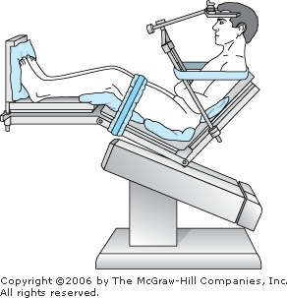

Slide 18
Cont…
Air bubbles entering the venous system ordinarily lodge in the pulmonary circulation, where their gases eventually diffuse into the alveoli and are exhaled.
Small bubbles are well tolerated by most patients. When the amount entrained exceeds the rate of pulmonary clearance, pulmonary artery pressure progressively rises.

Slide 19
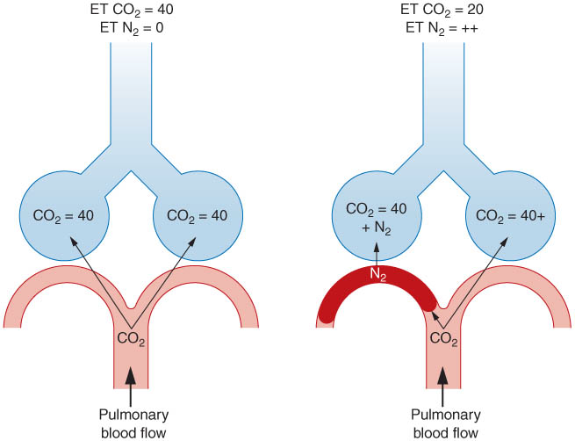

Slide 20
Clinical signs of venous air embolism
Clinically, signs of venous air embolism are often not apparent until large amounts of air have been entrained.
cardiac output decreases in response to increases in right ventricular afterload.

Slide 21
Cont…
A decrease in end-tidal CO2 or
A decrease in arterial oxygen saturation might be noticed prior to hemodynamic changes.
Slight increases in PaCO2
Sudden hypotension can occur well before hypoxemia is noted.

Slide 22
large amounts of air can produce sudden circulatory arrest by obstructing right ventricular outflow
when intra cardiac air impairs tricuspid and pulmonic valve function or blocks pulmonary arterioles.
Paradoxic air emboli PFO

Slide 23
Monitoring
Precordial Doppler ultrasonography is the standard monitor, and the probe is placed along the right parasternal border at the fourth intercostal space. It can detect as little as 0.25 mL of air.
Transesophageal echocardiography (TEE) is the most sensitive of all

Slide 24
Cont…
Pulmonary artery pressure monitoring is as sensitive as capnography.
Monitors that measure the decrease in blood pressure and cardiac output are the least sensitive.

Slide 25
Prevention of Venous Air Embolism
Decrease the gradient between the heart and the site of surgery
Maintain normovolemia to hypervolemia
Apply bone wax during surgery
Avoid positive end-expiratory pressure

Slide 26
Treatment of Venous Air Embolism
Notify the surgeon to flood the surgical site
Lower the operative site
Stop N₂O administration
Give 100% O₂
Perform aspiration through a central venous line
Consider compression of the jugular veins
Provide cardiopulmonary support (fluids, pressors, inotropes)

Slide 27
Pneumocephalus
During these procedures, air may enter the supratentorial space, much as air enters an inverted bottle.
N₂O should not be given because of the possibility of contributing to a tension pneumocephalus.

Slide 28
Cont…
Air readily enters the subarachnoid space as CSF is lost during surgery. In patients with cerebral atrophy,
drainage of CSF is marked; air can replace CSF on the surface of the brain and in the lateral ventricles.

Slide 29
Cont…
Expansion of a pneumocephalus following dural closure can compress the brain.
Postoperative pneumocephalus can cause delayed awakening and continued impairment of neurological function.

Slide 30
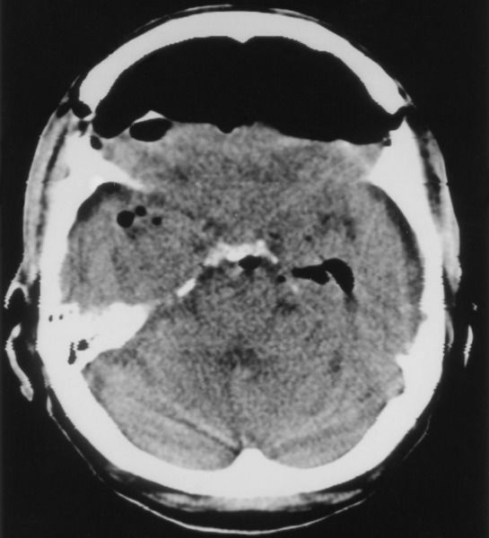

Slide 31
Obstructive Hydrocephalus
Infratentorially located masses can obstruct flow of CSF at the level of the fourth ventricle or the cerebral aqueduct.

Slide 32
Brain Stem Injury
Operations in the posterior fossa can injure vital circulatory and respiratory brain stem centers as well as cranial nerves or their nuclei.
Such injuries occur as a result of direct surgical trauma, retraction, or ischemia.
Damage to respiratory centers is said to be nearly always associated with circulatory changes

Slide 33
Other concerns are peripheral nerve injuries and head/neck/tongue edema.
In addition,a serious concern in any posterior fossa procedure is the possibility of injury to the lower cranial nerves

Slide 34
Brachial plexus injuries are a particular problem in the lateral/park bench positions when the “up” arm is pulled caudally to improve access to the retromastoid area, or when the head/neck is excessively rotated.
Ulnar nerve injury.

Slide 35
Pressure blisters/skin necrosis of the face caused by inadequate weight distribution on a horseshoe headrest.
Blindness caused by pressure on the eyes in the prone position.
Quadriplegia associated with extreme flexion of the neck

Slide 36
All these problems are avoidable but only by careful attention to position, nerve stretch, padding, and so forth.

Slide 37
Case
A 63-year-old woman with a brain tumor presents for bifrontal craniotomy in the supine position. She is neurologically intact but has had a recent onset of headaches, nausea, and blurred vision.
The magnetic resonance imaging (MRI) scan has revealed a large meningioma near the sagittal sinus.
Following induction of anesthesia and the start of surgery, the end-tidal carbon dioxide starts to decrease and the patient becomes hypotensive.

Slide 38
Questions
1. How is increased ICP treated?
2. How is venous air embolism (VAE) detected and treated?

Slide 39
What are the contraindications to the sitting position?
4. How would you induce and maintain anesthesia in this patient?
5. How do anesthetic agents and vasoactive drugs affect cerebral blood flow (CBF) and ICP?

